Slide 1


CLIENT ACCOUNT SYSTEM
OCEAN - GROUP 6

Slide 2

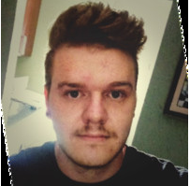
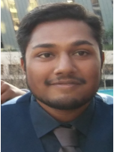
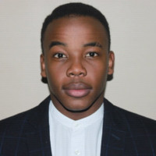
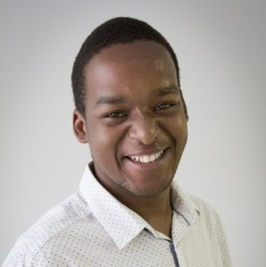
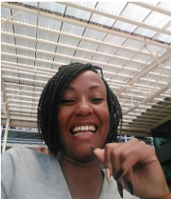
MEET THE TEAM
WALDO
VAN DER MERWE
BAVEN PAVADEY
THABO NTSOANE
BANDILE DLAMINI
LEBOGANG NTLATLENG
Database set up & Logs
DB functions & Unit Testing
Integration & front-end
Server creation & hosting
Integration & API calls

Slide 3
TECHNOLOGIES USED
SQLITE
NODE JS
EXPRESS JS
HEROKU
ANGULAR JS
Project Management: ZENHUB
Testing : Mocha and Chai

Slide 4
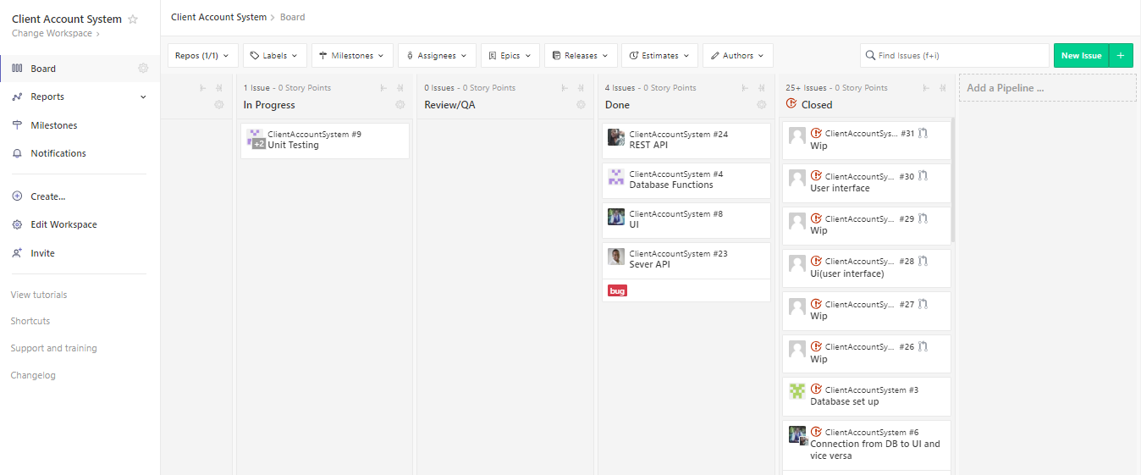
PROJECT MANAGEMENT TOOL
WE USED ZENHUB AS OUR PMT BY CREATING ISSUES THAT NEED TO BE RESOLVED

Slide 5
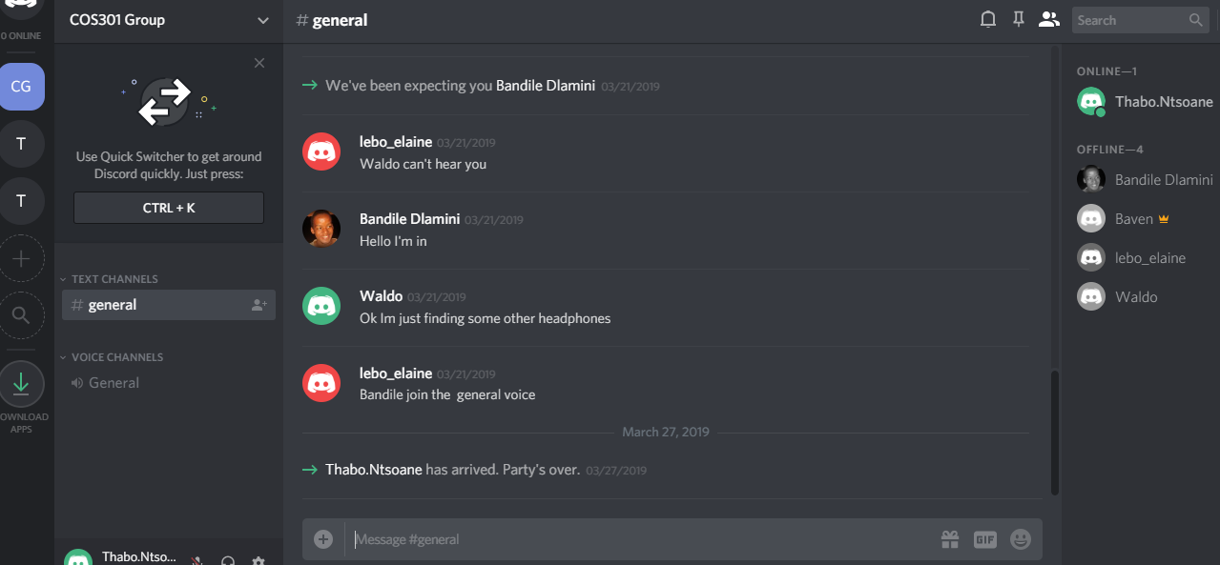
COMMUNICATION
WE USED DISCORD TO COMMUNICATE

Slide 6
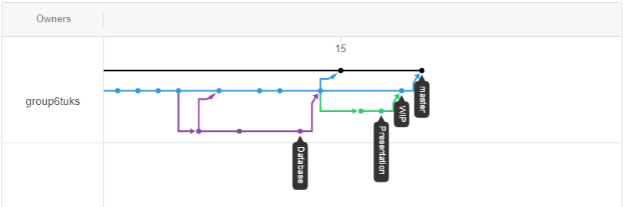
GIT STRUCTURE

Slide 7
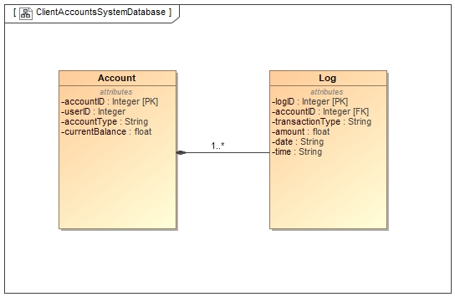
CLASS DIAGRAM

Slide 8
UNIT TESTING
DEMO…

